Slide 1


From past shocks to future uncertainties
navigating 25 years of euro area challenges
Daniel Gros, CEPS, Bocconi University
Farzaneh Shamsfakhr, CEPS
Monetary Dialogue Papers, February 2024

Slide 2
THE FIRST 20 YEARS OF THE EURO
Financial markets as the main source of tension in the first 15 years.
German reunification set off a diverging path between Germany and the Southern European countries, with construction sector was at the heart of the divergence
Global housing and credit boom coupled with a profound asymmetry within the euro area created first inflationary pressures and then deflationary when the GFC set in.
(Mild) inflationary pressures during the boom phase results in inflation increased briefly to over 3% in 2008, forcing the ECB to increase rates.
The bursting of the bubble (first global, then euro) led to weak demand and a strong fall in inflation.
Energy and raw material price fluctuations overlay this inflationary/deflationary cycle.

Slide 3
Profound cyiclical divergences: Germany versus South

Slide 4
Financial cycle: from de-synchronized to comovement

Slide 5
THE AFTERMATH OF THE BOOM/BUST CYCLE (2014-19)
After the acute period of euro area crisis of 2011-2012, the problem was to prevent from falling too far below that target and preventing deflation.
Excessive fear of deflation since prices sticky downwards, energy price fluctuations trigger large monetary policy interventions (PSPP).
Large asset purchases lock in large fiscal risk.

Slide 6
THE PAST 5 YEARS (2019-2024)
Unprecedented challenges for monetary policy, partially misread.
Covid 19: Brief period of financial market panic in March 2020 required intervention. But panic short lived.
The pandemic triggered a sectoral recession followed by a ‘K-shaped’ recovery. Monetary policy blunt instrument to stimulate the economy with sectoral shocks.
Ukraine war: The energy price shock of 2022 represented a classic supply shock, but was recognised much too late.
The macroeconomic models used by the ECB (as by many other central banks) were a poor guide for policy because they assume that inflation always returns to the target.
Curious asymmetry 2014 (oil price down) and 2022 (oil prices up).
Experience shows high inflation much more likely than deflation.

Slide 7
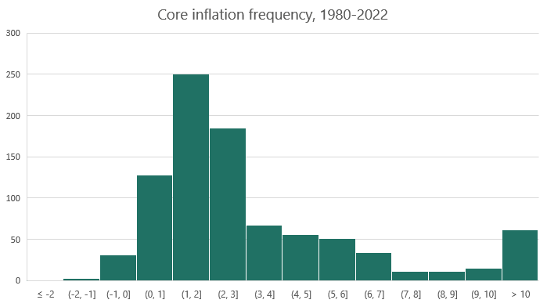
The inflation process is not symmetric. Large positive inflation rates are much more likely than large-scale deflation.
Source: Authors’ elaborations based on OECD data.
Note: The sample includes 20 countries in Western Europe, Northern America, plus Japan, Australia and New Zealand. The vertical axis indicates the frequency, the horizontal axis indicates the inflation range corresponding to each bar.

Slide 8
FUTURE CHALLENGES-CLIMATE RISK
Climate change il likely to bring substantial economic cost, but it is a slow moving process unlikely to threaten price stability or lead to systemic financial crisis.
Empirical literature find limited direct impacts of extreme weather event (mainly hot summers) on inflation for advanced economies including the euro area.
Transition risks should be manageable given stress test of high carbon prices and diversified nature of the European economy.
The continuing advance of China as a major competitor in key industries for the EU is likely to represent a more important source of shocks than the green transition.

Slide 9
Conclusion
First 15 years a unique combination of circumstances (mainly German unification) that is unlikely to occur again. Plus: Common crisis management institutions further strengthen ability to to deal with asymmetric shocks.
=> Financial instability less of a threat to price stability.
The formal symmetry of the inflation target adopted in 2021 needs rethink given asymmetric behaviour of inflation.
One focus of the next monetary strategy review should be a clarification whether the ECB’s target of 2% over the medium run refers only to average, or whether the variability around the target also matters.

Slide 10
THANK YOU

