Slide 1
WTO Law and Sustainable Development in the Era of Geopolitics
Huaxia Lai
Assistant Professor, Peking University School of international studies
March 28, 2024

Slide 2

An Expansive Understanding of SDG
WTO rules were not originally drafted to accommodate the broad range of SDG concerns.
Efforts to make new WTO rules with SDG in mind have accomplished only limited results.
MC13: plastic pollution, fisheries subsidies, promoting circular economy, phasing out fossil fuels

Slide 3

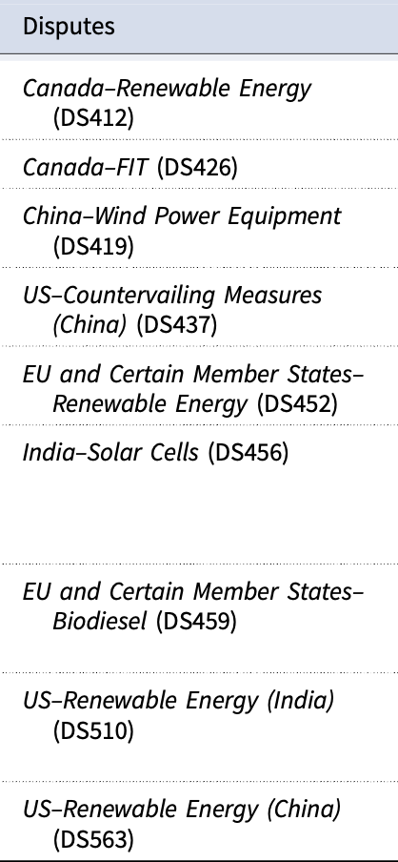
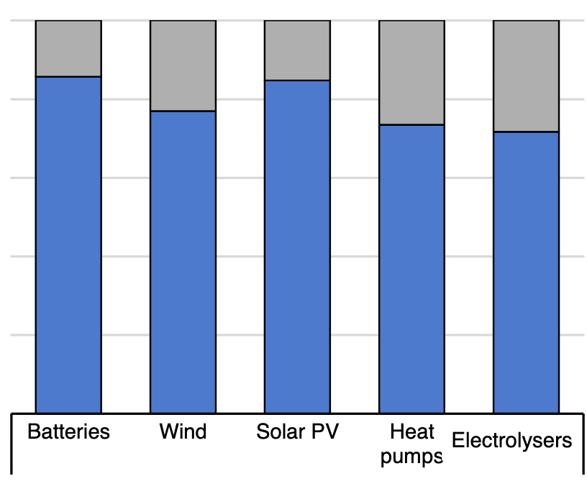
Clean Energy Production is Highly Concentrated.
Source: WTO Committee on Trade and Environment

Slide 4
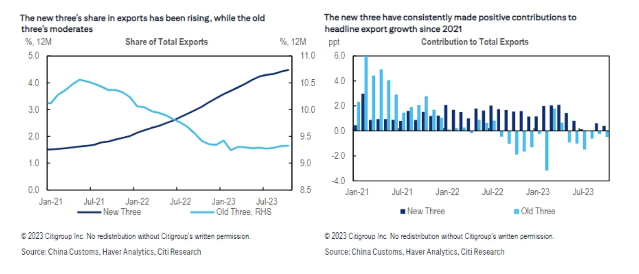
“New Three”
China’s globally competitive “New Three” export are all in clean energy sector.
solar cells, lithium-ion battery, and electric vehicles, instead of
furniture, clothing, and household appliance as “Old Three”
The rise of “New Three” allegedly owes much to government subsidies.
The “New Three” have become targets of tariffs from US and EU.

Slide 5
Clean Energy Disputes at WTO
On March 26, 2024, China initiated dispute settlement proceedings against the United States at the WTO, contesting “discriminatory subsidies” under the U.S. Inflation Reduction Act (IRA) that may exclude EVs from China.
“Under the disguise of responding to climate change, reducing carbon emission and protecting environment, these subsidies are in fact contingent upon the purchase and use of goods from the United States, or imported from certain particular regions."

Slide 6
WTO AB and SDG
In the deadlock of WTO rule making, the WTO Appellate Body has played a critical role in preserving and delineating the regulatory space for non-trade public policy goals in a line of disputes featuring trade-environment tension.
US-Reformulated Gasoline: “the General Agreement is not to be read in clinical isolation from public international law.”
US-Shrimp/Turtle: “exhaustible natural resources” under GATT Article XX(g)
EC-Asbestos: “like products”
US-Tuna(II): read regulatory space into TBT Agreement in the absence of Art.XX equivalent
Canada-Renewable Energy: benefit analysis provides some shelter to the SCM Agreement for renewable energy subsidies

Slide 7
Looking Ahead
Should GATT Art. XX be applicable to the SCM Agreement?
An effective AB is more likely to push forward reconciling trade and SDG goals
in the absence of binging legal framework on climate change and clean energy
when geopolitical competition makes any efforts to conclude new agreements nearly futile

